Slide 1



Implementation and Evaluation of Strategies to Improve Catch-up Vaccination among Children under Five years, Siaya County, Kenya (2022-2024)
Dr. Christina Mwachari
CIHEB Kenya
Insert Institutional Affiliations
Insert Name of Presenter & Co-authors
Thematic Area: Community Health Systems & Primary Healthcare
Insert high-resolution institutional Logos – if available
Insert high-resolution institutional Logos – if available
Insert high-resolution institutional Logos – if available
Kenya Health Security Convention | 5th – 8th May 2026 | Mombasa - Kenya

Slide 2
Background
Globally, immunization is one of the most cost-effective public health interventions averting an estimated 4-5 million deaths annually from vaccine-preventable diseases (VPDs)¹
WHO Catch-up implementation guidance to reach children who missed vaccination between 2019 and 2022 following the COVID-19 pandemic ²
  In Kenya, coverage for routine immunization recovery required renewed attention to delayed and missed vaccination among children in the second year of life and beyond
  As of 2022, about 55% of children aged 12–23 months were fully vaccinated according to the Kenyan national schedule, with 53% being vaccinated by the appropriate age. Notably, 2% of this cohort had not received any vaccination ³

Slide 3
Policy Response - Need for Operational Evidence
  In 2023, Kenya revised national immunization guidelines to incorporate routine catch-up vaccination (vaccines given at a later date to children who missed them at the recommended age)¹
  Despite the inclusion of catch-up vaccination policy in the revised guidelines, there is limited operational evidence on its implementation
  This assessment presents an implementation model to strengthen routine delivery of catch-up immunization in Siaya County in Oct 2023
1. Kenya Revised Immunization Guidelines, 2023

Slide 4
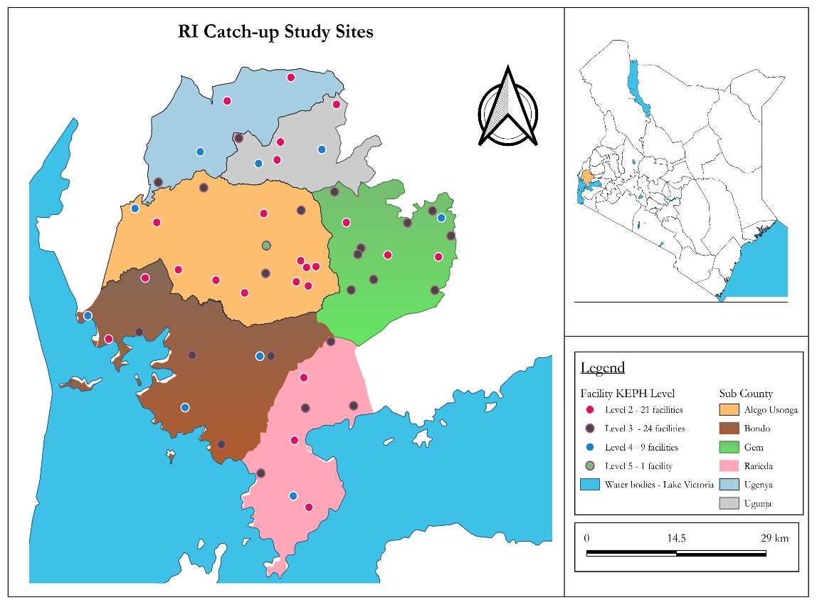
Methodology
Design
  Pre-post implementation assessment
  Gaps identified at baseline (Nov 2022-Jan 2023)
  Strategies co-designed at a national workshop
  Implementation: Oct 2023 - Sept 2024
Setting
  Siaya County, Kenya
  55 public health facilities (representative sample of 110 Public Health Facilities)
  facility and community health system

Slide 5
Strategies used to strengthen routine catch-up vaccination in Siaya
Joint training and supportive supervision on EPI and catch-up guidelines
Monthly CME sessions on catch-up vaccination
Training of CHWs on revised EPI & catch-up guidelines
Capacity building for healthcare providers and community health actors
Strengthening of immunization documentation and reporting
Distribution of standardized MOH immunization data tools
Quarterly data quality assessments and county-level data review meetings
Enhancement of appointment scheduling and defaulter tracing systems
Mentorship on appointment scheduling and follow-up, with appointment diaries and communication tools (phones and airtime)
Engagement of CHWs in defaulter tracking and referral
Reduction of missed opportunities for vaccination (MOV) and outreach
Tailored review of facility screening practices with mentorship for all facility staff
CHW engagement to strengthen vaccination status screening
Microplanning support for targeted outreach sessions after stockouts
Development of Information Education and Communication materials to support catch-up vaccination
Integration of catch-up messages into routine facility health talks
Caregiver education
5

Slide 6
Monitoring & Evaluation and Data analysis
Data Inputs
MOH Immunization registers
Continuous Monitoring
Ongoing tracking using the evaluation tool
Data Review Systems
Periodic review of routinely collected immunization and child health data at all levels
Regular Data quality checks
Data Analysis
Data Quality Assurance
Data Use & Decisions
Evidence based decision making
Summarize trends in vaccination uptake
Continuous Feedback

Slide 7
Results: Training and mentorship reached 2,153 healthcare workers
Standardized messaging improved caregiver awareness of immunization importance and catch-up availability
​​​​​​​​
Improved use of MoH registers and home-based records enhanced identification of missed doses, reconciliation, and timely defaulter follow-up
“For my first child, I stopped taking them for vaccination at nine months. For this one, I am following step by step because I learned that children could receive vaccines until they are five years.” (Caregiver, Gem)
“When you do proper documentation… you can identify defaulters and follow them up.” (HCP, Alego Usonga)

Slide 8
Catch-up vaccination contributed to 18% of total doses administered
(Jan 2024–Sept 2024)
Intervention enabled delivery of 168,533 vaccine doses across implementation sites, of which 30,336 (18%) were catch-up doses
Vaccine series with the highest catch-up vaccination:
  Rotavirus (stockouts/product switch)
  Measles-Rubella (stockouts)
  Malaria (newly introduced vaccine in some sub-counties)
Low catch-up vaccination for early infant doses
Notes:
Give an example of vaccines given later in life MR2 etc

Slide 9
Rapid scale-up of appointment systems improved adherence, with more children vaccinated
Use of the standard appointment system by HCWs increased from 9 facilities (16%) at baseline to all 55 facilities (100%) within three months and was sustained for 12 months
​​A total of 46,597 children were scheduled for vaccination appointments and 35,424 (76%) were honored, demonstrating the value of the appointment system

Slide 10
Defaulter Tracing
Defaulter Tracing
Results highlight effective tracing mechanisms and strong linkage to vaccination services
The remaining gap suggests an opportunity to improve tracing coverage and reach untraced defaulters
3,944
Defaulters Identified
3,239 (82%)
Defaulters Traced
2,965 (92%)
Vaccinated

Slide 11
Discussion
Feasibility and Institutionalization of Catch-Up Vaccination
This assessment demonstrates that routine catch-up vaccination can be feasibly integrated into existing RI systems in resource-constrained settings​​ and contributes to increased vaccination coverage among children
Catch-up can help address missed opportunities for vaccination, and dropout rates- key barriers to achieving full immunization
​​Catch-up implementation directly addressed existing gaps in coverage by repositioning screening, structuring appointments, standardizing recording, and creating clear referral pathways
This assessment demonstrates that under-immunization can be recovered through better organization of routine services without additional infrastructure

Slide 12
Persistent Challenges and Study Limitations
Staff shortages, competing workload, vaccine stock-outs, incomplete contact information, and caregiver mobility were the key challenges
Programmatic implementation evaluation, not designed for causal attribution
Concurrent system factors may influence improvements
Routine data is vulnerable to documentation error despite efforts to strengthen concordance
This assessment focuses on implementation and service delivery outcomes, not antigen-specific coverage changes or long-term completion trajectories

Slide 13
Conclusion
Routine catch-up vaccination can be embedded within primary healthcare delivery
​​Routine catch-up addresses missed opportunities for vaccination at both the facility and community levels
​​Systematic screening at every contact, continuity mechanisms (appointments, defaulter tracing), accurate documentation, and robust community follow-up are key to success
​​Routinization of catch-up responds to the pressing global immunization challenge of recovering under-immunized children without exclusive reliance on campaigns
​​This assessment offers policy-relevant and scalable lessons for Kenya and other low- and middle-income settings

Slide 14
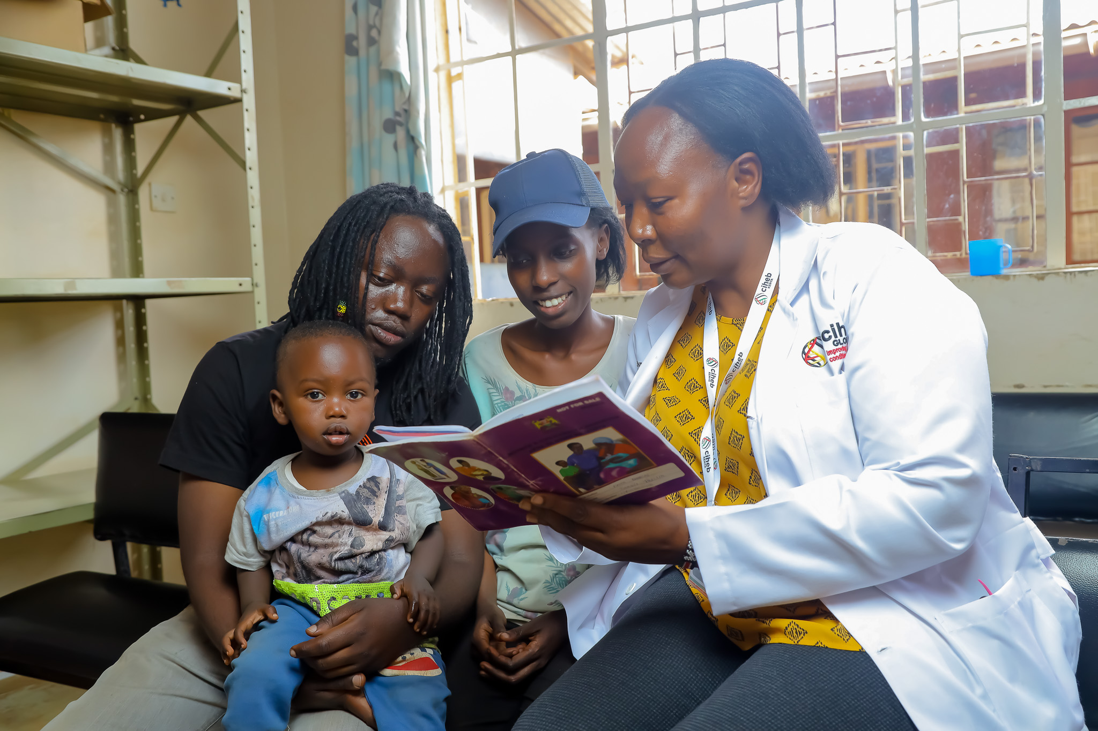
Acknowledgements
National Vaccine Immunization Program
Siaya County Health Department
CIHEB Kenya TRACK Program
Global Immunization Division, US CDC

Slide 15

Thank you!
Scan to visit our website
#KeHSCon2026
@NPHIKenya
www.nphi.go.ke

